Slide 1

Index Extraction From Textbooks
KOM Lab Design Workshop – Group XXX
Yujin Wang Ruolin Huang Fabian Roesch
guantao0815@gmail.com
hrl96fz@foxmail.com
Tim Steuer
Don‘t forget to reference your title picture
Picture Reference

Slide 2
Our Task: Index Extraction From Textbooks
Motivation
Index of a book can give insight of it‘s contents
Most Textbooks are PDF, however PDF is a diverse format
Idea
It’s difficult for machine to understand the content of PDF
The content of XML is a good structured and can be easily understood by machine
Realization
Input: A textbook in PDF Format
Intermediate Format: txt/String
Output: extract The index list of PDF and save it in a .xml file
KOM et al.: Widescreen Powerpoint Template for KOM [KOM19]
Example of a footnote reference: You can place your references used on this slide here, in addition to the Sources slide. Remove if not used.

Slide 3
Implementation Ideas(algorithms): Two Steps
First Step
Input: PDF file
Output: TXT file
(Maybe put pictures of PDF → TXT → XML?)
Second Step
Input: TXT file
Output: XML file
可以在这里空白处放上第一页的图？中间再加上Txt的图标
KOM et al.: Widescreen Powerpoint Template for KOM [KOM19]
Example of a footnote reference: You can place your references used on this slide here, in addition to the Sources slide. Remove if not used.

Slide 4
Status Quo
Programming language and library chosen
Java with Apache PDFBox library
Golden Standard
Five handwritten sample XML files (To verify the correct rate of the created XML files)
Raw text extraction
Implementing a simple version
Performance well in one PDF but it still need to be optimized for general using
KOM et al.: Widescreen Powerpoint Template for KOM [KOM19]
Example of a footnote reference: You can place your references used on this slide here, in addition to the Sources slide. Remove if not used.

Slide 5
The main Problems should be Solved
Main Problems
How to determine what is the Index in any given PDF
How to identify subphrases
How to remove non-relevant content (e.g. pagenumber, header, etc)
KOM et al.: Widescreen Powerpoint Template for KOM [KOM19]
Example of a footnote reference: You can place your references used on this slide here, in addition to the Sources slide. Remove if not used.

Slide 6
Some Special Cases
是否考虑配上PDF截图，还是继续在这里写文字？
KOM et al.: Widescreen Powerpoint Template for KOM [KOM19]
Example of a footnote reference: You can place your references used on this slide here, in addition to the Sources slide. Remove if not used.

Slide 7
Sources
[KOM19] Multimedia Communications Lab, KOM (2019). Widescreen Powerpoint Template for KOM.
This is an example!

Slide 8
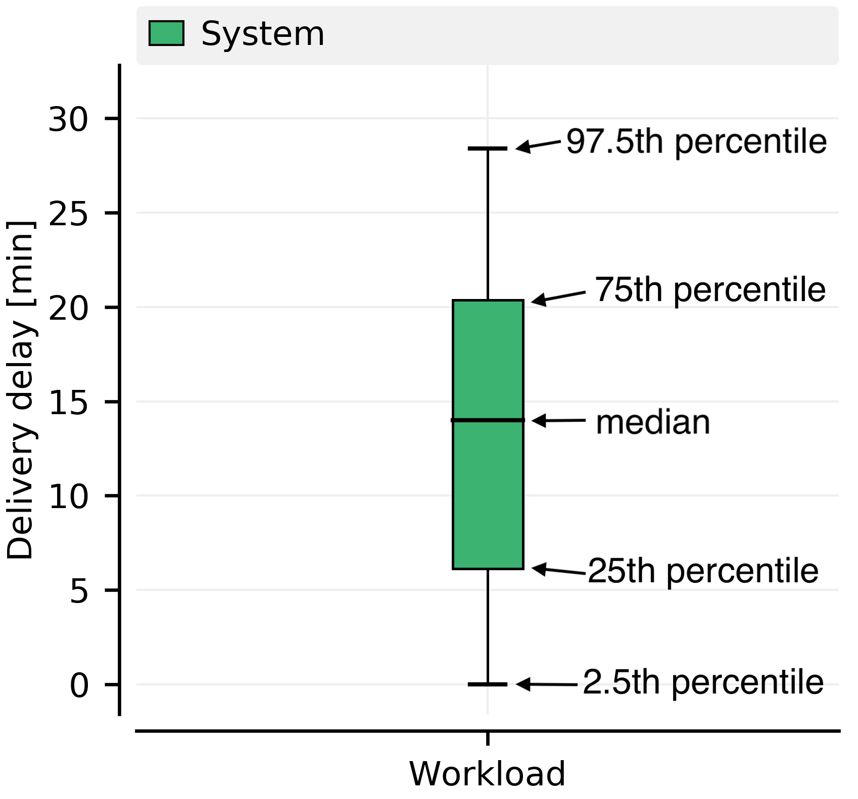
Box Plot Description Backup: „This is a backup slide“
The Problems to be Solved
The Problems to be Solved
Description of a box plot. [KOM19]
Picture description
Picture reference
KOM et al.: Widescreen Powerpoint Template for KOM [KOM19]
Example of a footnote reference: You can place your references used on this slide here, in addition to the Sources slide. Remove if not used.

